Slide 1
Predictive Modeling

Slide 2
Business Analytics
Harnessing the power of data…second most important organizational asset
Data Management
Data Mining
Decision Modeling

Slide 3

Business Analytics
http://youtu.be/uP89kaDU40c

Slide 4

Why Analytics? Why Now?
We have entered the era of ‘Big Data’
15 out of 17 sectors in the US have more data stored per company than the US Library of Congress
40% projected growth in global data generated per year
Business data doubles every 1.2 years
For less than $600, you can buy all of the world’s music

Slide 5



Why Analytics? Why Now?
Digital data is everywhere – every economy, every sector, every organization, and almost every individual
Data is now a factor of production – economic activity cannot take place without data
There is data now on every aspect and activity of organizations – embodying problems, trends, opportunities to create added value and learn
Technologies to ‘manage’ and techniques to ‘work’ the big data - along with early successes – are key catalysts

Slide 6
What is Analytics?
Data Management
Data Mining
Decision Modeling

Slide 7

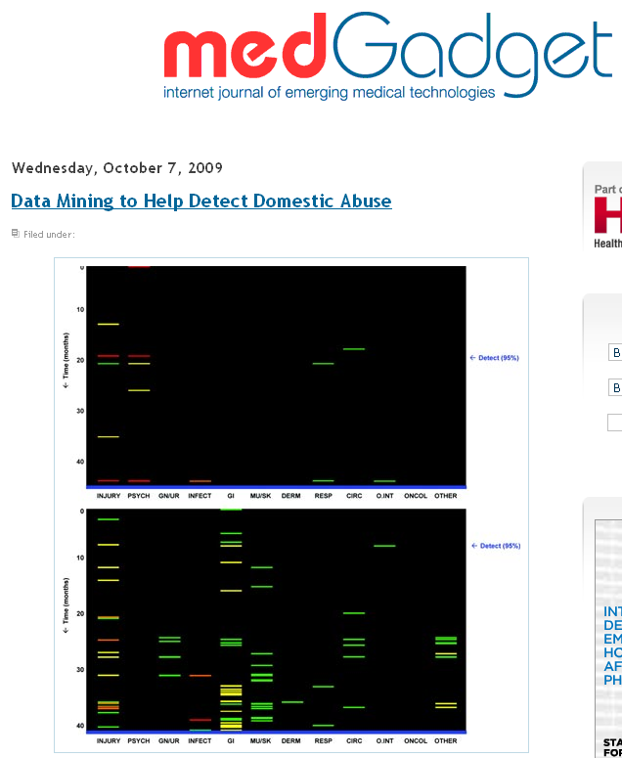

Slide 8

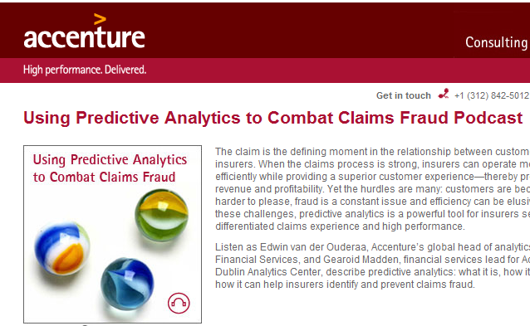
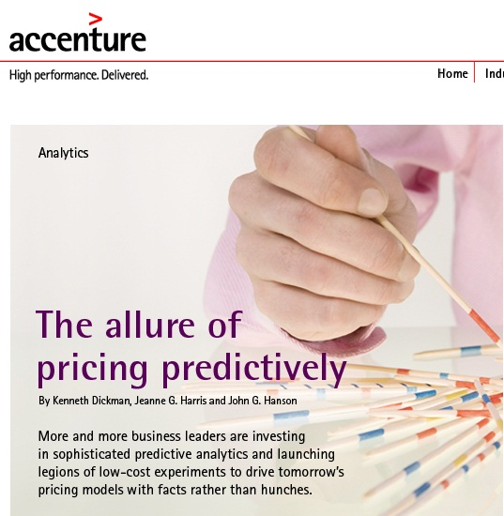

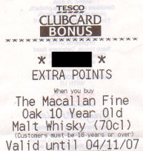
Notes:
Targeted marketing, Customer churn

Slide 9
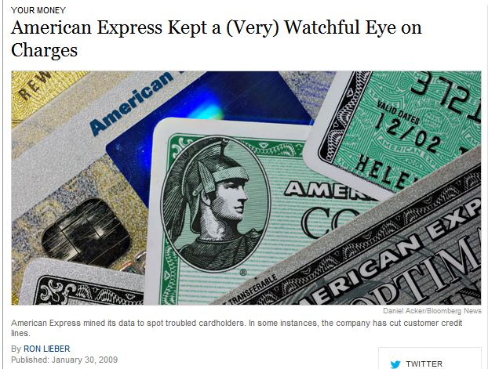
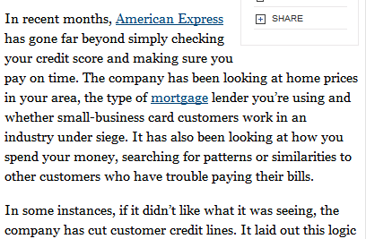

Slide 10
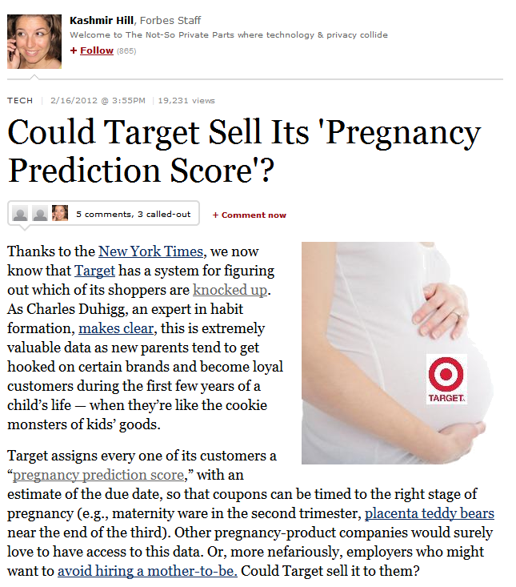

Slide 11


Slide 12
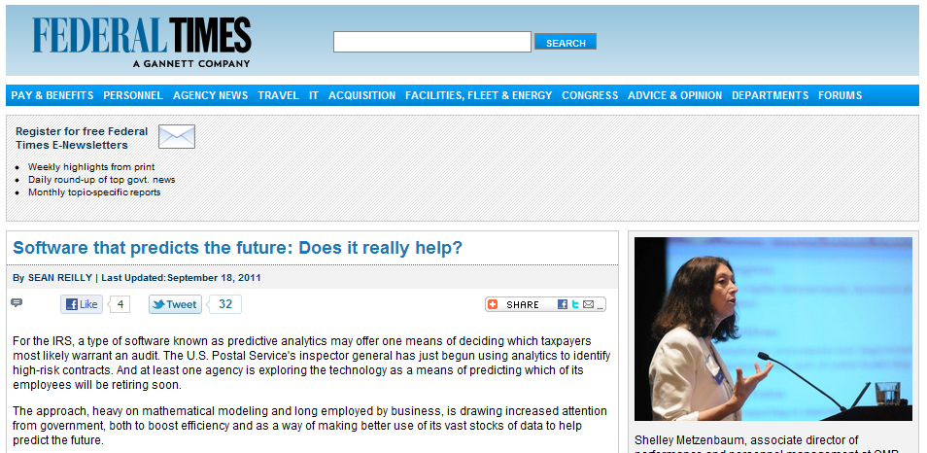

Slide 13
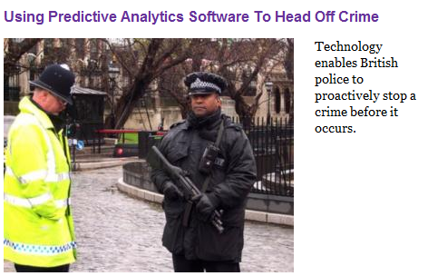
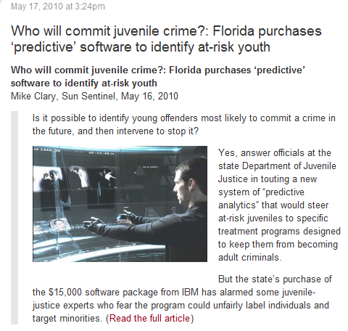

Slide 14
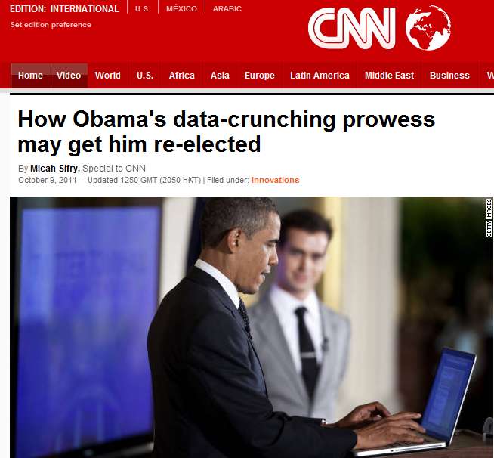

Slide 15
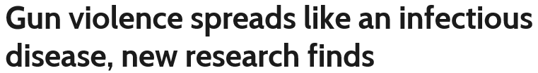

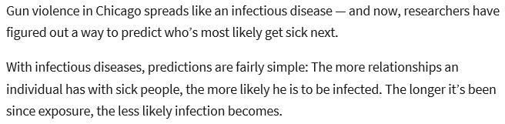
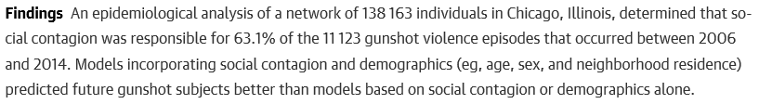
http://www.pbs.org/newshour/rundown/gun-violence-infectious-disease-research/

Slide 16
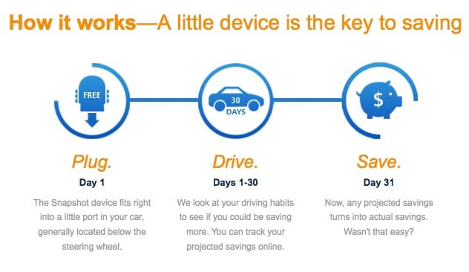

The Snapshot device records vehicle speed and time of day, when the device is plugged in and unplugged from the vehicle, the Vehicle Identification Number and may record vehicle location using GPS. For Third Party Sources, your driving data, which includes vehicle speed, time information and odometer readings, is collected by others and provided to us with your consent. Other information, such as trip duration, miles driven and rates of acceleration and braking, is derived from the data provided.
The App records driving information, mobile phone information and App analytics information. Driving information includes vehicle speed and location using GPS, time information and sensor data from the phone’s magnetometer, gyroscope and accelerometer. Other information, such as trip duration, and rates of acceleration and braking, is derived from the speed, location and time information. Because the App is not connected to your vehicle, it will collect the driving information of any vehicle you occupy, even as a passenger.
Mobile phone information includes Wi-Fi status, whether your screen is locked, whether you are calling or otherwise using your phone, whether your call is hands-free, motion activity or activity recognition, whether the phone is connected to a Bluetooth® device, referring/exit pages, date/time stamp and operating system data available to the App. The App does not record the content of your communications or the identity of the person with whom you are communicating.
App analytics information includes how often you use the App, aggregated usage, performance data and other App activity.

Slide 17
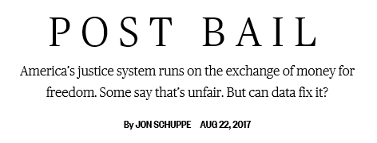
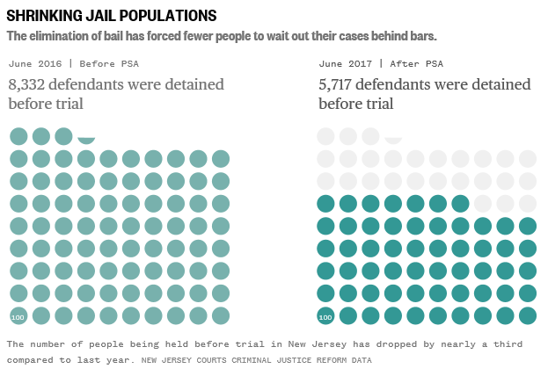
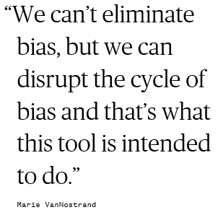
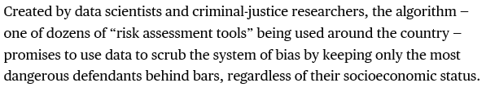
https://www.nbcnews.com/specials/bail-reform

Slide 18
How Business Analytics Creates Value
‘fact-based’ management
Understand important trends and patterns in complex environments that are otherwise difficult to gather
Which can lead to
Enhance customer satisfaction
Segment/tailor products & services
Enhanced decision-making
Transparency
Innovating new business models
Experimentation

Slide 19
Data Mining
Data mining (knowledge discovery from data)
  Extraction of interesting (non-trivial, implicit, previously unknown and potentially useful) patterns or knowledge from huge amount of data
Is everything “data mining”?
  We will take a very broad view of data mining – key question is, “Can we learn something useful (e.g., having business value) by mining/studying/analyzing the data? Can we transform data into decisioning knowledge?”

Slide 20
Data Mining Models
Data Mining
Pattern Discovery
(or Descriptive Models)
Predictive
Models
Time
series
Clustering
Sequence
Discovery
Classification
Summarization
Regression
Association
Rules

Slide 21
Are All the “Discovered” Patterns Interesting?
Data mining may generate thousands of patterns: Not all of them are interesting
Interestingness measures
  A pattern is interesting if it is easily understood by humans, valid on new or test data with some degree of certainty, potentially useful, novel, or validates some hypothesis that a user seeks to confirm
Objective vs. subjective interestingness measures
  Objective: based on statistics and structures of patterns, e.g., support, confidence, etc.
  Subjective: based on user’s belief in the data, e.g., unexpectedness, novelty, actionability, etc.

Slide 22


Predictive Modeling Example
categorical
categorical
continuous
class

Slide 23
Data Mining: the downside
No guarantees that you will always be able to find patterns and be able to predict
Does it imply that
  Analytics can result in wasted time and resources?
  Analytics is a risky endeavor?

Slide 24
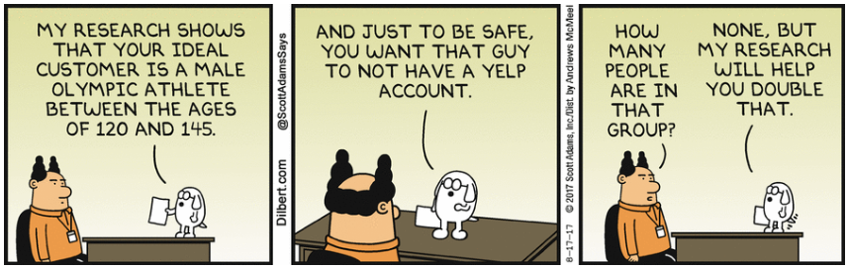
Data Mining: other downsides
Non actionable – cannot be put to use
Data fishing– finding spurious structure in data that is not real

Slide 25
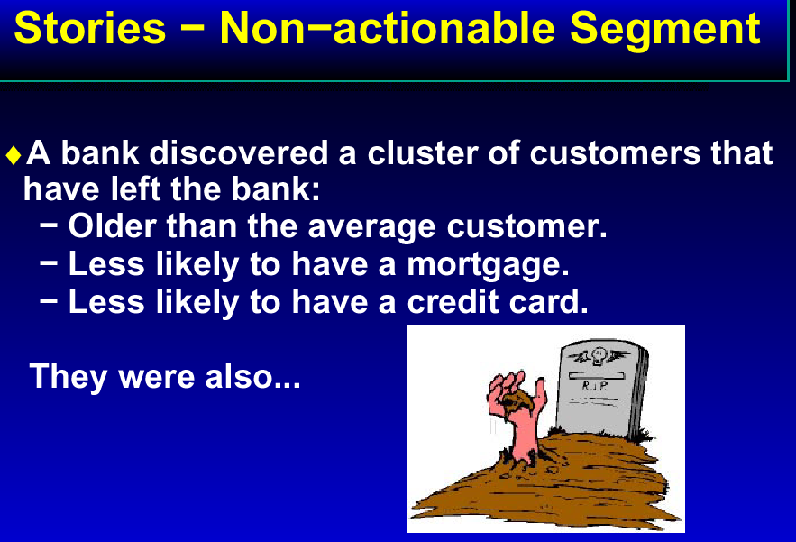

Slide 26
Non Actionable – other reasons
No organizational processes in place to ensure the results are put to use
Prediction occurs too late
“In practice” the data to predict is not available
Is illegal!
  https://en.wikipedia.org/wiki/Redlining

Slide 27
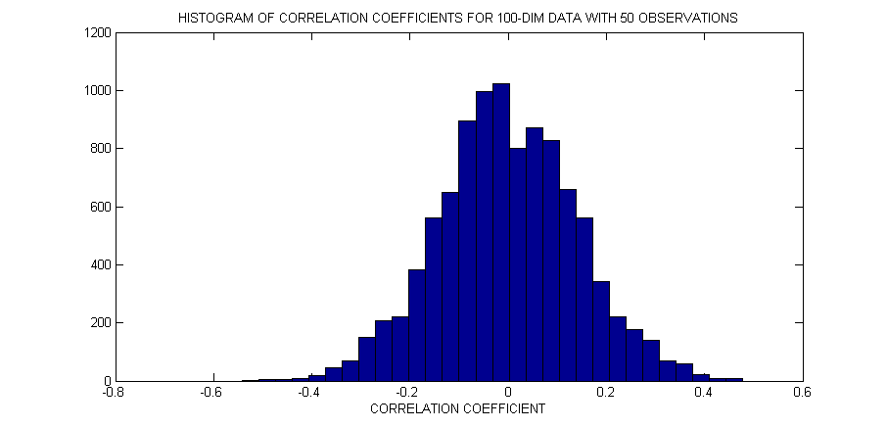
Example of “data fishing”
Example: data set with
  50 data vectors
  100 variables
  Even if data are entirely random (no dependence) there is a very high probability some variables will appear dependent just by chance.
Notes:
https://www.google.com/trends/correlate/search?e=switch&t=weekly&filter=switch&p=us#

Slide 28
SEMMA Approach to Data Mining
Business Imperative
+
Sample
You sample the data by creating one or more tables. The sample should be large enough to contain the significant information, but small enough to process.
Explore
You explore the data by searching for anticipated relationships, unanticipated trends, and anomalies to gain understanding and ideas.
Modify
You modify the data by creating, selecting, and transforming the variables to focus the model selection process.
Model
You model the data by using the analytical tools to search for a combination of the data that reliably predicts a desired outcome.
Assess
You assess competing predictive models by building charts to evaluate the usefulness and reliability of the findings from the data mining process.

Slide 29
Effort for each data-mining process step
100
90
80
70
60
50
40
30
20
10
0
Business
Objective
Determination
Data
Preparation
Data
Mining
Analysis of
Results and
Knowledge
Assimilation

Slide 30
Data Mining – Not a ‘one-time’ initiative
Changes in the Business Environment
New Data Become Available

Slide 31
Points to Ponder
With great power comes great responsibility
Organizational changes needed to harness the benefits of analytics
Analytics fast emerging as a critical business skill
http://www.analytics-magazine.org/

